Slide 1


Machine Learning Approach to Sales Prediction
Swagata Priyadarshini Das
ADTU/0/2024-26/MCAM/022

Slide 2
Introduction
Objective
Dataset
Predict Sales using Linear Regression
Advertising.csv
Features
Target
TV, Radio, Newspaper
Sales

Slide 3

Data Preparation
01
02
Loaded dataset
Removed missing values
using pandas
using dropna()
03
Split data
into features (X) and target (Y)

Slide 4
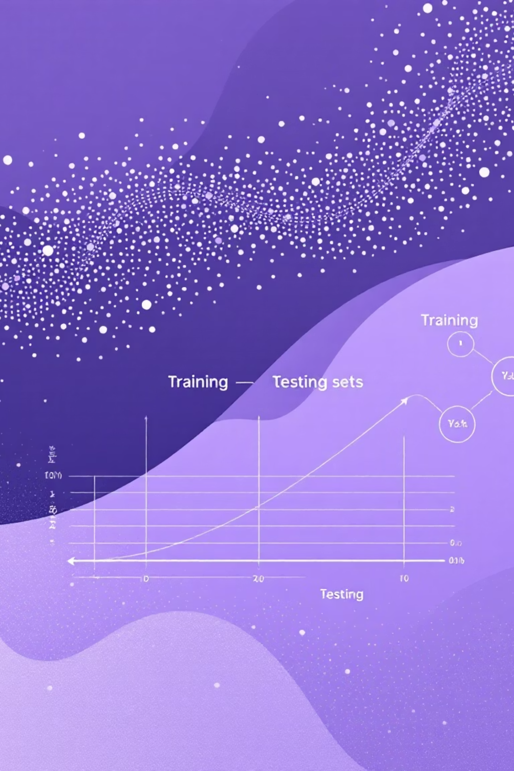



Model Building
Train-test split
(80% Train, 20% Test)
Trained Linear Regression model
Generated predictions
on test data

Slide 5
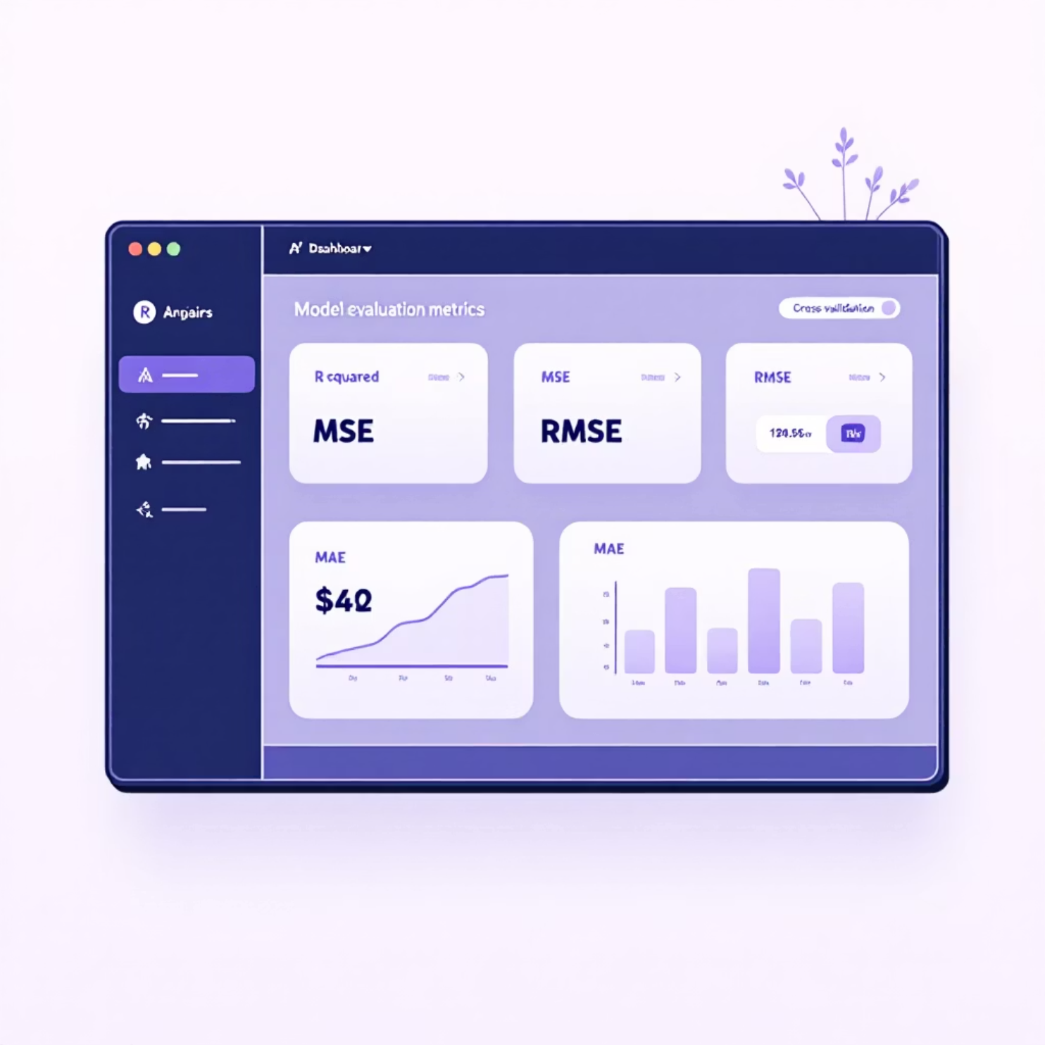
Model Evaluation
R² Score for accuracy
MSE, RMSE, MAE for error measurement
Also used 5-Fold Cross-Validation

Slide 6
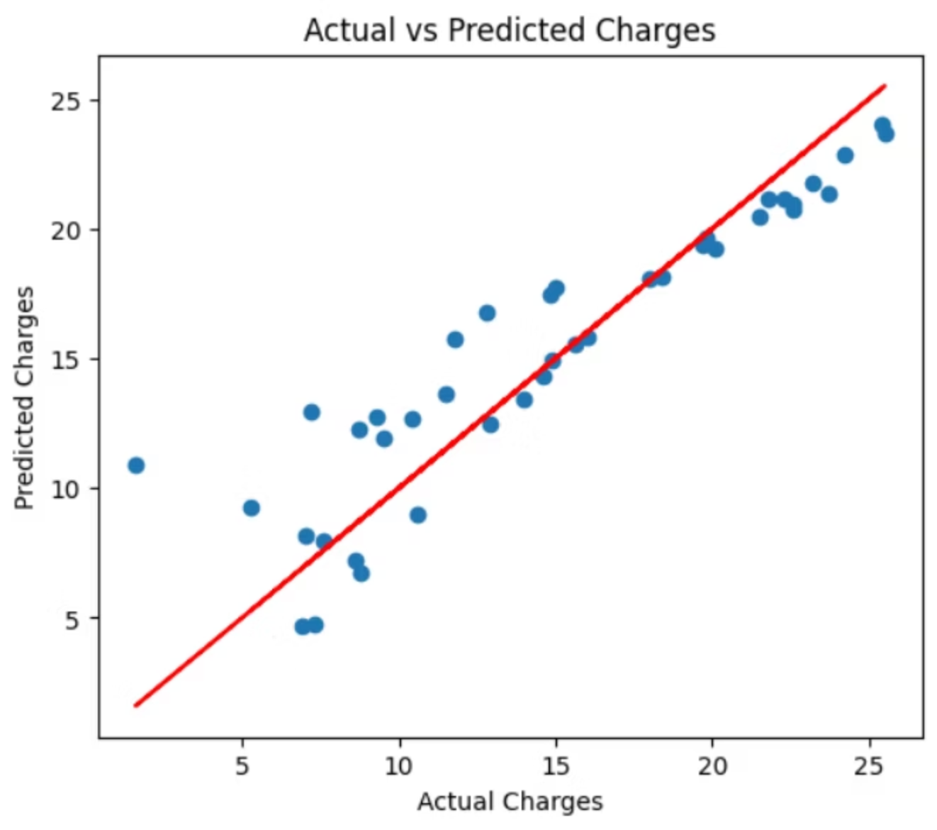
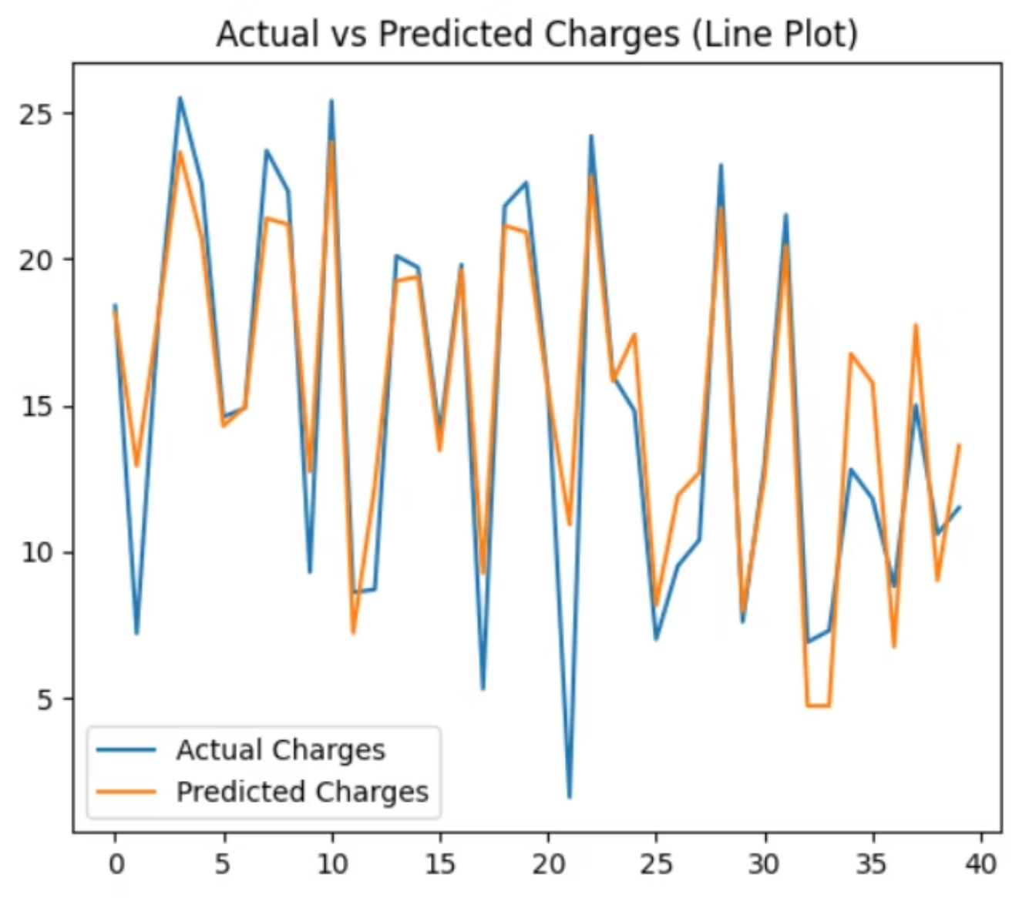
Visualizations
• Actual vs Predicted Scatter Plot • Line Plot comparing actual and predicted values

Slide 7




Model Saving & Conclusion
Saved model
Model performs well
Useful for
using pickle (model.sav)
for sales prediction
marketing budget planning

Slide 8


